Slide 1

GWN Series
Wi-Fi 6 (802.11ax)
Access Points

Slide 2

GWN SERIES
Powerful Networking Solutions
Grandstream's powerful Wi-Fi access points offer high network performance, industry-leading coverage ranges, fast provisioning, and multiple management options.

Slide 3
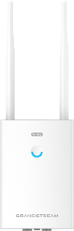

GWN SERIES Wi-Fi 6 ACCESS POINTS
Options available for any scenario
GWN7660
GWN7664
GWN7660LR
GWN7664LR
NEW

Slide 4

GRANDSTREAM IN THE WI-FI ALLINACE
Wi-Fi 6 Access Points
Wi-Fi Alliance® is the worldwide network of companies bringing you Wi-Fi®, one of the world's most valued communications technologies. Our vision is to connect everyone and everything, everywhere.
Wi-Fi Alliance drives global Wi-Fi adoption and evolution through thought leadership, spectrum advocacy, and industry-wide collaboration.

Slide 5

Wi-Fi 6 - ACCESS POINTS
GWN Series
Wi-Fi CERTIFIED products have undergone rigorous testing. When a product passes the tests successfully, the manufacturer can use the Wi-Fi CERTIFIED logo.
Certification means that a product has been tested in numerous configurations with a diverse sample of other devices to validate interoperability with other CERTIFIED Wi-Fi equipment operating in the same frequency band.

Slide 6
Wi-Fi 6 - ACCESS POINTS
GWN Series
Why should I choose Wi-Fi 6?
The interest in Wi-Fi 6 is a global improvement that users will experience in increasingly common situations where many devices are connected to the same network.
There will also be an improvement in lower latency and security.

Slide 7
Wi-Fi 6 - ACCESS POINTS
OFDMA – Maximizing Transmission Efficiency
OFDMA, is a technology that enables an Access Point to connect with many devices at once. OFDMA partitions each radio channel into smaller resource units that it strategically allocates across clients.
In contrast, a legacy AP can communicate with only one user per channel at a time, and must hold the line open until a given transmission concludes. As a result, wireless performance often suffers in high-density environments.

Slide 8

Wi-Fi 6 - ACCESS POINTS
OFDMA – Maximizing Transmission Efficiency
Wi-Fi 5
Wi-Fi 6
time
time
Channel Widht
Channel Widht
frequency
frequency
WLAN Packets
WLAN Packets

Slide 9
Wi-Fi 6 - ACCESS POINTS
BSS Coloring – Reducing Channel Overlap Problems
1
AP2
1
AP2
6
11
6
11
11
1
6
AP1
11
1
6
AP1
6
11
6
11
1
AP3
1
AP3
Without BSS Coloring
With BSS Coloring

Slide 10
Wi-Fi 6 - ACCESS POINTS
MU-MIMO Technology
Multi-user MIMO allows multiple Wi-Fi devices to simultaneously receive multiple data streams. A wireless access point (AP) can send data to four different Wi-Fi devices at the same time. MU-MIMO can greatly increase the network's throughput and is a real asset for high density networks
Though OFDMA and MU-MIMO allow multiple devices to simultaneously transmit, they are different. OFDMA can help in high-density environments, while MU-MIMO can aid in high-throughput applications.

Slide 11
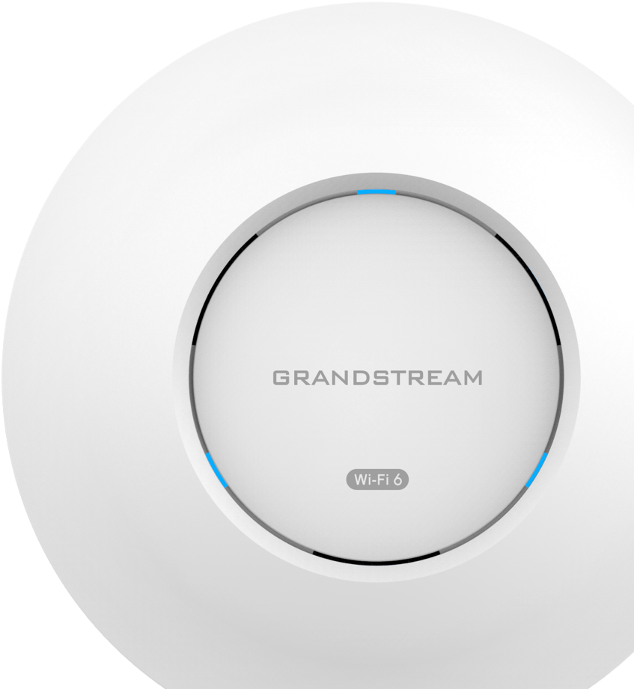
GWN7660 – 2x2:2 ACCESS POINT
Wi-Fi 6 – GWN Series
Added wireless throughput of 1.77 Gbps
DL/UL OFDMA and MU-MIMO technologies
Coverage range of up to 175 meters
Advanced QoS to ensure real-time performance of low latency applications
Enterprise-grade security features
Embedded controller can manage up to 50 local GWN series APs; GWN.Cloud offers unlimited AP management; GWN Manager offers premise-based software controller

Slide 12
GWN7660 – 2x2:2 ACCESS POINT
Wi-Fi 6 – GWN Series
Dual-Band Wi-Fi - 802.11ax
2.4 GHz
8 Mbps up to 573.5 Mbps
5 GHz
8 Mbps up to 1201 Mbps
Total Wireless Throughput
1.77 Gbps

Slide 13

GWN7660 – 2x2:2 ACCESS POINT
Wi-Fi 6 – GWN Series
256 Concurrent
Wi-Fi Devices
Thanks to Wi-Fi 6 technology, the GWN7660 is able to handle a high number of concurrent devices without sacrificing performance

Slide 14
GWN7664 – 4x4:4 ACCESS POINT
Wi-Fi 6 – GWN Series
3.55 Gbps aggregate wireless throughput
3.5 Gbps aggregate wired throughput
DL/UL OFDMA and MU-MIMO technologies
Coverage range of up to 175 meters
Advanced QoS to ensure real-time performance of low latency applications
Self power adaptation upon auto detection of PoE or PoE+
Embedded controller can manage up to 50 local GWN series APs; GWN.Cloud offers unlimited AP management; GWN Manager offers premise-based software controller

Slide 15
GWN7664 – 4x4:4 ACCESS POINT
Wi-Fi 6 – GWN Series
802.11ax
Dual-Band
2.4 GHz
8 Mbps up to 1147 Mbps
5 GHz
8 Mbps up to 2402 Mbps
Total Wireless Throughput
3.55 Gbps

Slide 16
GWN7664 – 4x4:4 ACCESS POINT
Wi-Fi 6 – GWN Series
512 Concurrent
Wi-Fi Devices
Thanks to Wi-Fi 6 technology, the GWN7664 is able to handle a high number of concurrent devices without sacrificing performance.

Slide 17
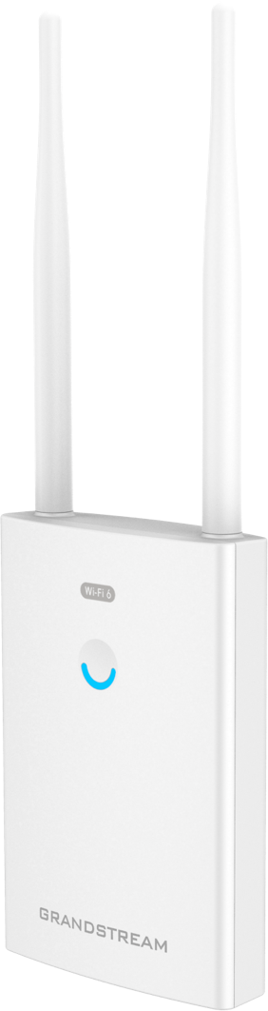
GWN7660LR – 2X2:2 OUTDOOR AP
Wi-Fi 6 – GWN Series
1.77 Gbps aggregate wireless throughput
2 Gigabit Ethernet Ports
DL/UL OFDMA and MU-MIMO technologies
Coverage range of up to 250 meters
Advanced QoS to ensure real-time performance of low latency applications
Flexibility of 2 detachable/changeable antennas for different application scenarios
Embedded controller can manage up to 50 local GWN series APs; GWN.Cloud offers unlimited AP management; GWN Manager offers premise-based software controller

Slide 18
GWN7660LR – 2X2:2 OUTDOOR ACCESS POINT
Wi-Fi 6 – GWN Series
Dual-Band Wi-Fi - 802.11ax
2.4 GHz
8 Mbps up to 573.5 Mbps
5 GHz
8 Mbps up to 1201 Mbps
Total Wireless Throughput
1.77 Gbps

Slide 19
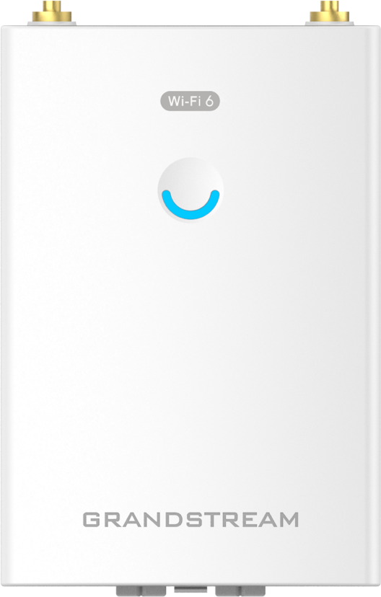
GWN7660LR – 2X2:2 OUTDOOR ACCESS POINT
Wi-Fi 6 – GWN Series
256+ Concurrent
Wi-Fi Devices
Thanks to Wi-Fi 6 technology, the GWN7660LR is able to handle a high number of concurrent devices without sacrificing performance.

Slide 20
GWN7664LR – 4X4:4 OUTDOOR AP
Wi-Fi 6 – GWN Series
3.55 Gbps aggregate wireless throughput
2 Gigabit Ethernet Ports
DL/UL OFDMA and MU-MIMO technologies
Coverage range of up to 300 meters
Advanced QoS to ensure real-time performance of low latency applications
Flexibility of 4 detachable/changeable antennas for different application scenarios
Embedded controller can manage up to 50 local GWN series APs; GWN.Cloud offers unlimited AP management; GWN Manager offers premise-based software controller

Slide 21
GWN7660LR – 4X4:4 OUTDOOR ACCESS POINT
Wi-Fi 6 – GWN Series
Dual-Band Wi-Fi - 802.11ax
2.4 GHz
8 Mbps up to 1147 Mbps
5 GHz
8 Mbps up to 2402 Mbps
Total Wireless Throughput
3.55 Gbps

Slide 22
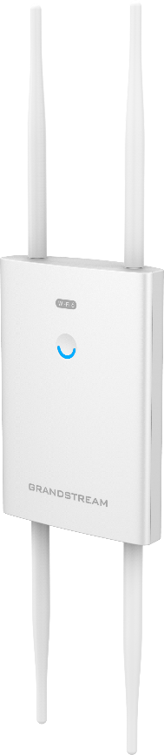
GWN7660LR – 2X2:2 OUTDOOR ACCESS POINT
Wi-Fi 6 – GWN Series
750+ Concurrent
Wi-Fi Devices
Thanks to Wi-Fi 6 technology, the GWN7664LR is able to handle a high number of concurrent devices without sacrificing performance.

Slide 23
MANAGEMENT OPTIONS – GWN SERIES
EMBEDDED
GWN.CLOUD
GWN MANAGER
NO ADDITIONAL COST
FREE DOWNLOAD
FREE TO USE
DEPENDS ON THE MASTER AP
CLOUD BASED PLATFORM
UP TO 3,000 APs
LOCAL
DEPLOYMENT
NO LIMIT IN THE NUMBER OF APs
LOCAL SERVER DEPLOYMENT
The various management options that Grandstream makes available to its customers are constantly evolving to offer the best functions and features no matter what the choice is.

Slide 24
Thank You!

