Slide 1

GWN Series
Wi-Fi 5 (802.11ac)
Access Points

Slide 2

GWN SERIES
Powerful Networking Solutions
Grandstream's powerful Wi-Fi access points offer high network performance, industry-leading coverage ranges, fast provisioning, and multiple management options.

Slide 3
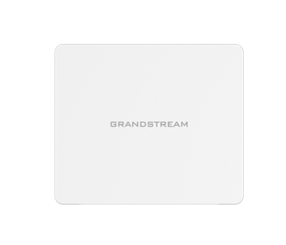
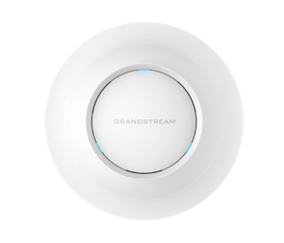
GWN SERIES ACCESS POINTS
Options available for any scenario
GWN7602
GWN7605
GWN7615
GWN7625
NEW
GWN7630
Indoor Acess Points

Slide 4
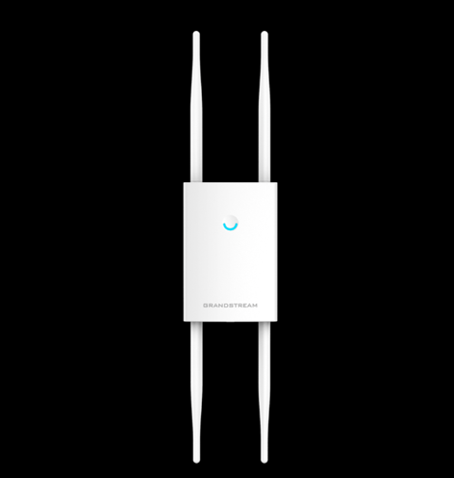
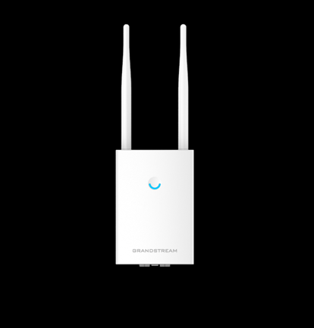
GWN SERIES ACCESS POINTS
Options available for any scenario
GWN7605LR
GWN7630LR
ACCESS POINTS FOR EXTERIORS
(WEATHERPROOF LONG-RANGE)

Slide 5
Indoor Wi-Fi Access Points

Slide 6

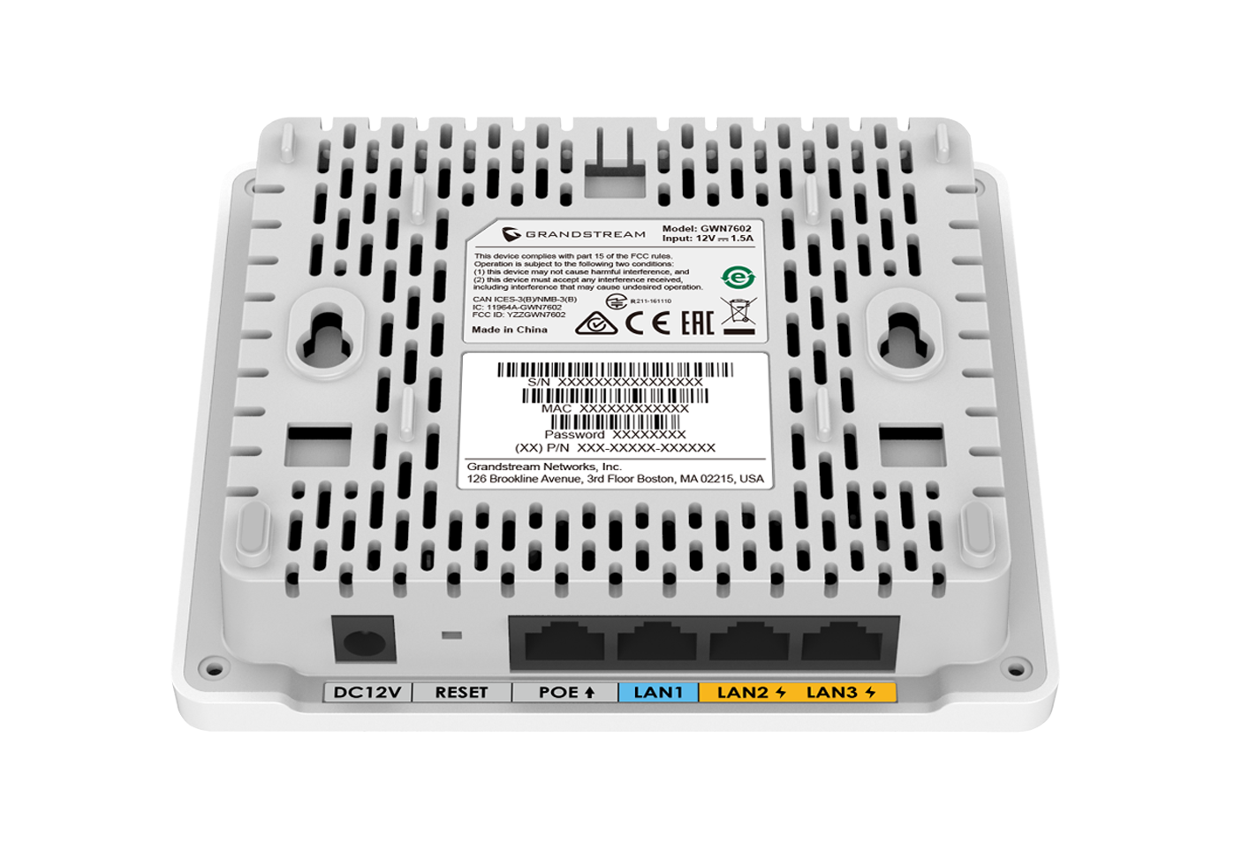
GWN7602 – Mid-Tier 802.11ac Wi-Fi Access Point
GWN Series
1.17Gbps aggregate wireless throughput, 1x Gigabit and 3x 100Mbit wireline speed
Up to 100-meters coverage range
Support for up to 80 Wi-Fi Client Devices
Self-power adaptation upon auto-detection of PoE/PoE+
2 dual-band internal antennas

Slide 7
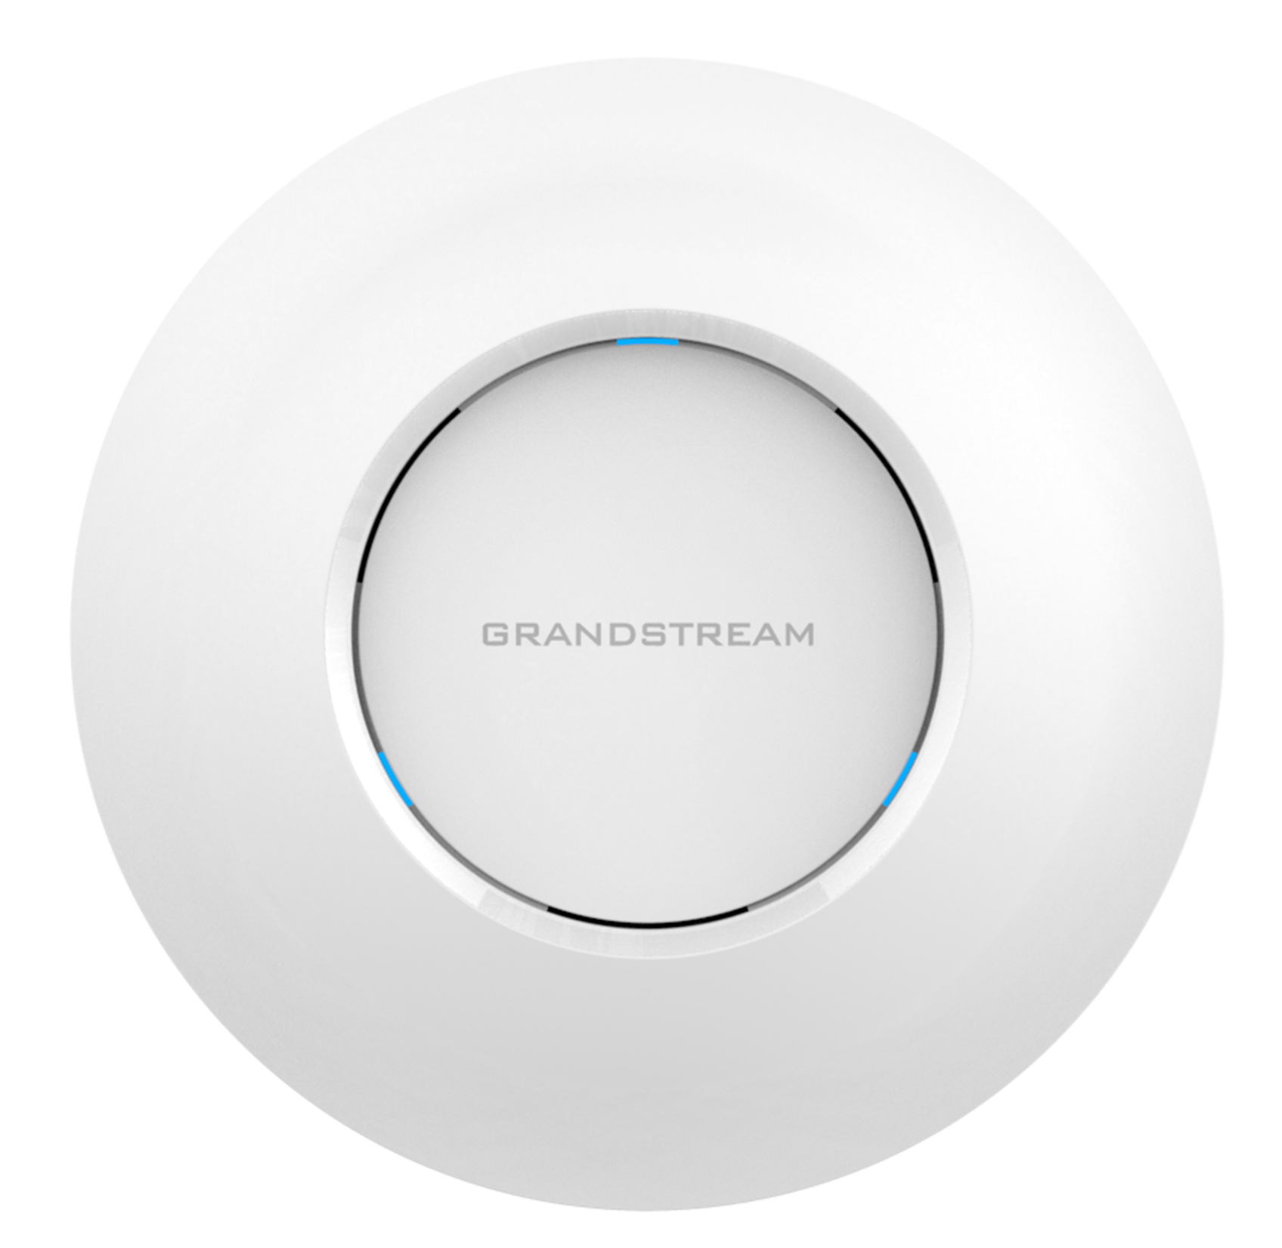
GWN7605 – 802.11ac Wave-2 2x2:2 Wi-Fi Access Point
GWN Series
1.27Gbps aggregate wireless throughput and 2xGigabit wireline ports
Up to 165-meters coverage range
Support for 100+ Wi-Fi Client Devices
Self-power adaptation upon auto-detection of PoE/PoE+
Dual-band 2x2:2 MU-MIMO with beamforming technology

Slide 8
GWN7615 – 802.11ac Wave-2 3x3:3 Wi-Fi Access Point
GWN Series
1.57Gbps aggregate wireless throughput and 2xGigabit wireline ports
Dual-band 3x3:3 MU-MIMO technology
Supports 200+ concurrent Wi-Fi client devices
Up to 175-meter coverage range
Anti-hacking secure boot and critical data/control lockdown via digital signatures

Slide 9
GWN7625 –4x4:4 and 2x2:2 Wi-Fi Access Point
GWN Series
2.03Gbps aggregate wireless throughput and 2xGigabit wireline ports
4x4:4 MU-MIMO technology on the 5G band and 2x2:2 MU-MIMO on the 2.4G band
Supports 200+ concurrent Wi-Fi client devices
Anti-hacking secure boot and critical data/control lockdown via digital signatures

Slide 10
GWN7630 – 802.11ac Wave-2 4x4:4 Wi-Fi Access Point
GWN Series
2.33Gbps aggregate wireless throughput and 2xGigabit wireline ports
Dual-band 4x4:4 MIMO technology
Supports 200+ concurrent Wi-Fi client devices
Up to 175-meter coverage range
Anti-hacking secure boot and critical data/control lockdown via digital signatures

Slide 11
Weatherproof Long-Range Wi-Fi Access Points

Slide 12
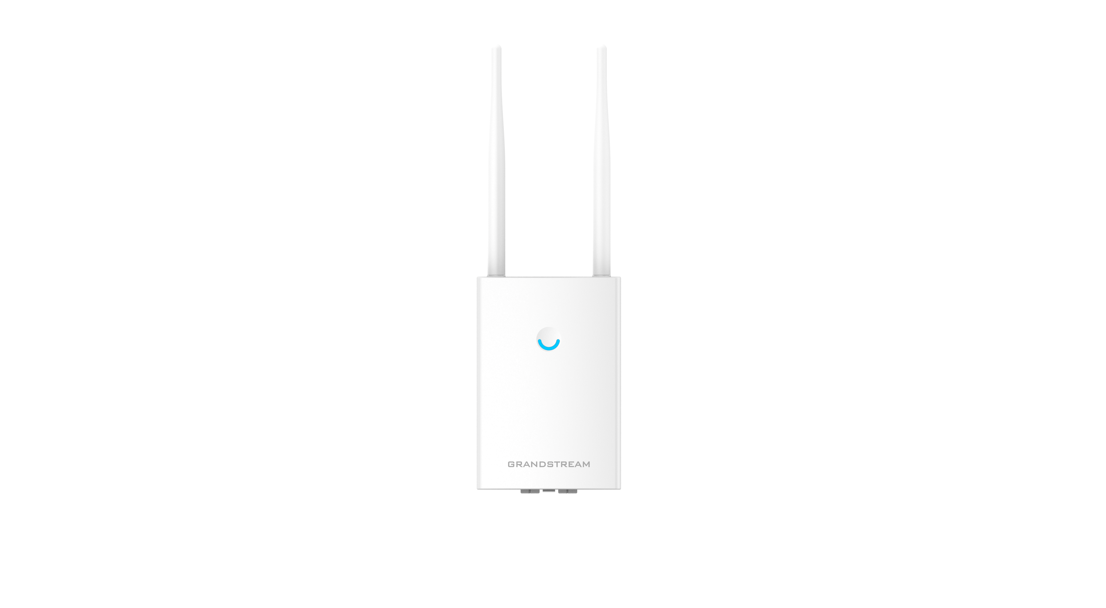
GWN7605LR – Long-Range Wi-Fi Access Point
GWN Series
1.27Gbps wireless throughput and 2x Gigabit wireline ports
Supports more than 100+ Wi-Fi client devices
250-Meter coverage range for superior device mobility
Dual-band 2X2:2 MIMO technology
IP66-level weatherproof capability when installed vertically
Flexibility of 2 detachable/changeable antennas for different application scenarios

Slide 13
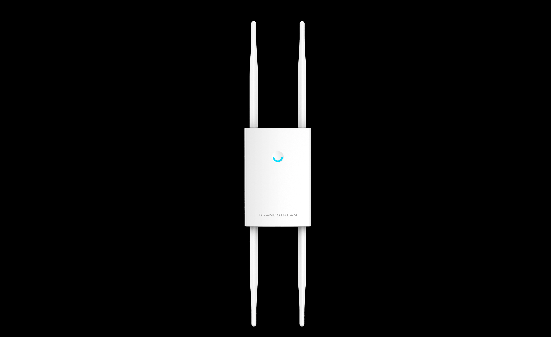
GWN7630LR – Long-Range Wi-Fi Access Point
GWN Series
2.33Gbps wireless throughput and 2x Gigabit wireline ports
Supports more than 100+ Wi-Fi client devices
300-Meter coverage range for superior device mobility
Dual-band 4X4:4 MIMO technology
IP66-level weatherproof capability when installed vertically
4 detachable/changeable dual-band omni-directional antennas

Slide 14
MANAGEMENT OPTIONS – GWN SERIES
EMBEDDED
GWN.CLOUD
GWN MANAGER
NO ADDITIONAL COST
FREE DOWNLOAD
FREE TO USE
DEPENDS ON THE MASTER AP
CLOUD BASED PLATFORM
UP TO 3,000 APs
LOCAL
DEPLOYMENT
NO LIMIT IN THE NUMBER OF APs
LOCAL SERVER DEPLOYMENT
The various management options that Grandstream makes available to its customers are constantly evolving to offer the best functions and features no matter what the choice is.

Slide 15
Thank You!

