Slide 1

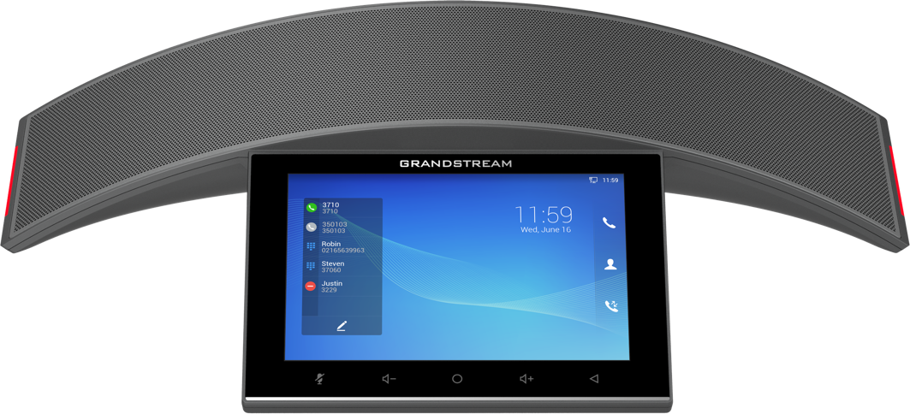
GAC2570
Enterprise Conference Phone

Slide 2








GAC2570 ENTERPRISE CONFERENCE PHONE
Highlights
Full-duplex HD speakerphone, AEC, mic beamforming
12 omnidirectional mics, 5m pickup range
Dual-band
Wi-Fi 6
Integrated
Bluetooth 5.0
Built-in Rechargeable battery with 4- hour talk-time
Built-in 12-way conferencing
Zoom Rooms Certified

Slide 3

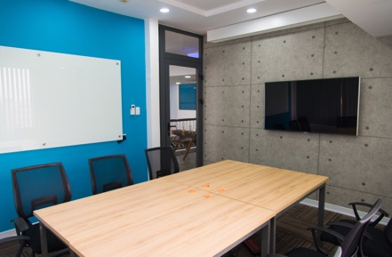




GAC2570 DEPLOYMENT SCENARIOS
Conference Rooms
Huddle Rooms
Open Offices
Training Rooms
Board Rooms
Classrooms
Notes:
MMedical

Slide 4
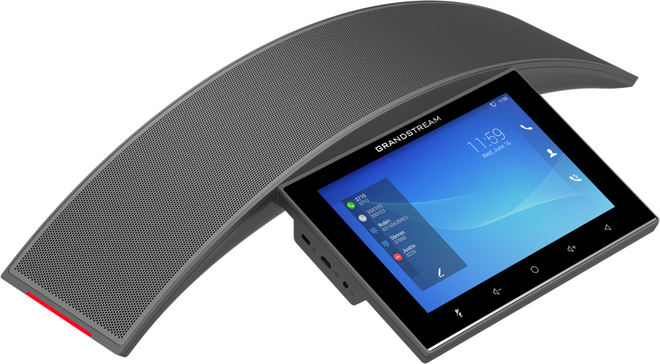

GAC2570
Enterprise Conference Phone
Full-duplex HD Speakerphone with HD acoustic chamber
Advanced Echo Cancellation and Microphone beamforming technology
12 omnidirectional mics with Multichannel Microphone Array Design (MMAD)
5m voice pickup distance
Integrated Bluetooth 5.0
Dual-band Wi-Fi 6 support
Built-in Rechargeable battery with 4 hour talk time
Built-in 12-way audio conferences
Runs Android 10

Slide 5


POWERFUL AUDIO CONFERENCING
GAC2570
Full Duplex Speakerphone with HD acoustic chamber
10-watt high-fidelity speaker
Advanced Echo Cancellation (AEC)
Microphone beamforming array technology
12 omnidirectional mics with MMAD (multichannel microphone array design)
5-meter pickup distance
Pair with up to 2 GMD1208 mics to extend audio reach up 20 meters from GAC2570

Slide 6

BUILT ON ANDROID
GAC2570
Run on the Android operating system (version 10)
Full access to the millions of apps in the Google Play Store
SDK and API available for development of custom Android apps
Provides endless deployment options and solutions

Slide 7

WI-FI & BLUETOOTH
GAC2570
Integrated dual-band Wi-Fi 6 support for easy deployments and flexible usage
Wi-Fi ideal for open office concepts
Built-in Bluetooth for pairing wireless headsets, speakers, microphones and mobile devices

Slide 8

RECHARGEABLE BATTERY
GAC2570
Built-in 3300mAh rechargeable battery
Provides up to 4 hours of talk time
Pairs with Wi-Fi to enable true wireless usage

Slide 9


ZOOM ROOMS CERTIFIED
GAC2570

Slide 10
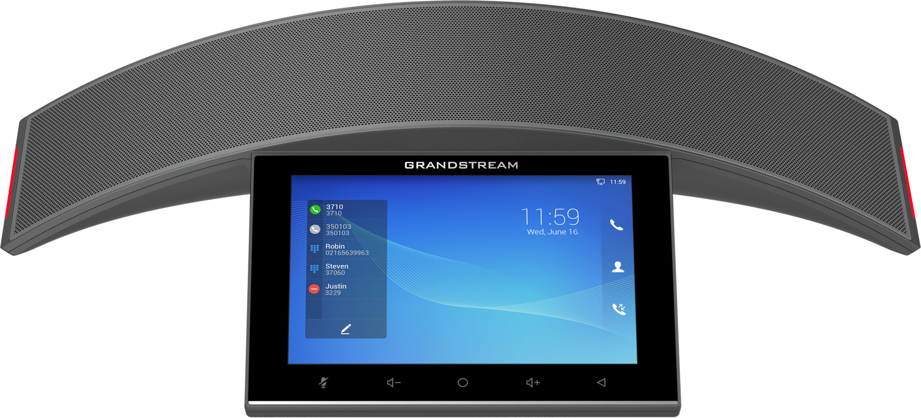
LED Status
Indicator
LED Status
Indicator
Call
Contacts
Call History
Mute /
Unmute
Volume
Down
Volume
Up
Home
Back

Slide 11
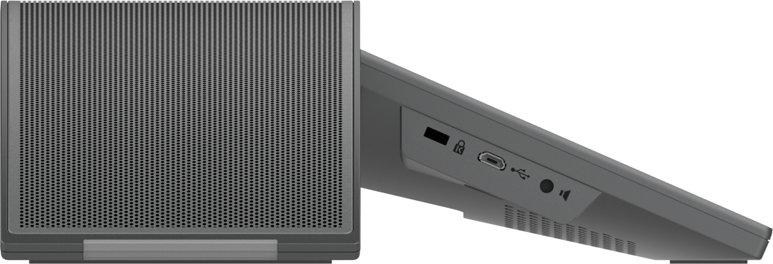
Kensington Lock
Micro
USB
Line-Out
1x Gigabit network port + 1x media located underneath the speaker

Slide 12
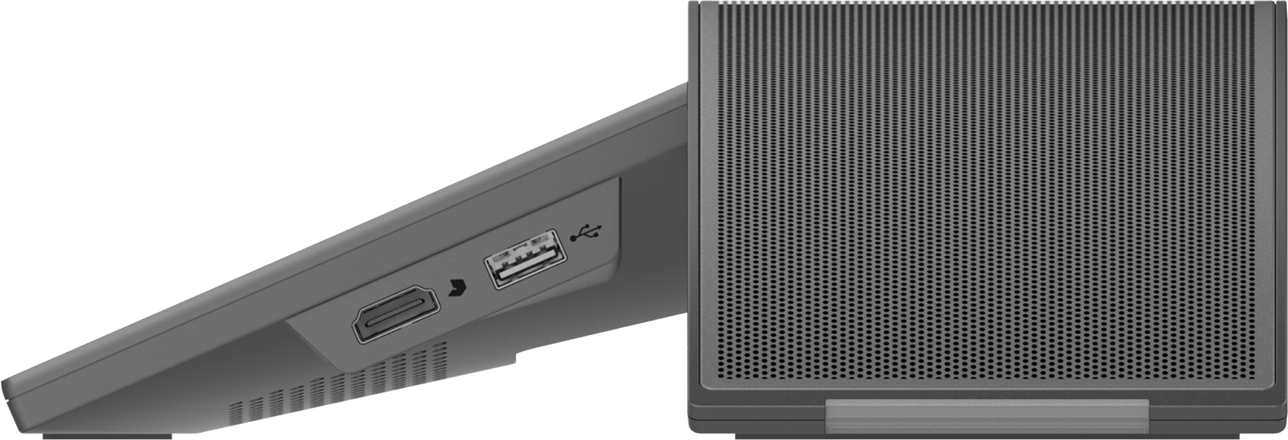
USB
HDMI In
1x Gigabit network port + 1x media located underneath the speaker

Slide 13
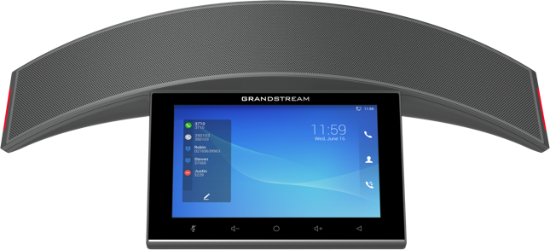
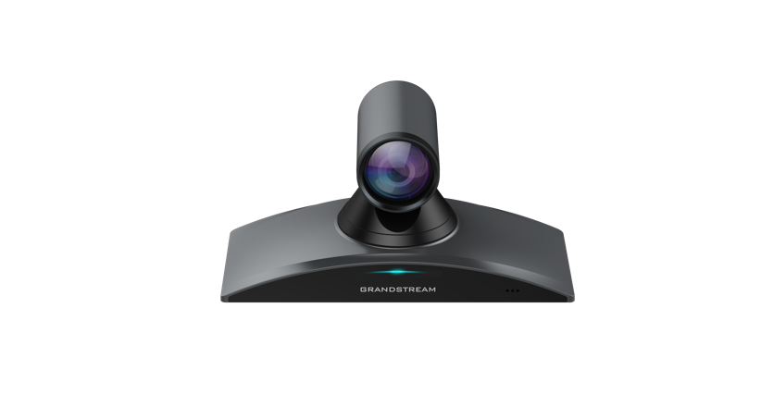
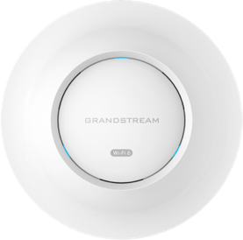
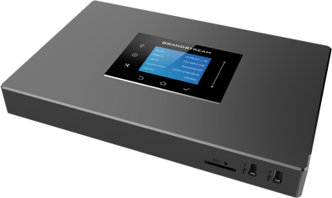
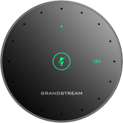
INTEGRATE WITH GRANDSTREAM SOLUTIONS
GVC Series
Extend the audio to/from any GVC Series device to create an immersive experience
GMD1208
Pair with up to 2x GMD1208 mics to extend audio coverage up to 20m from the GAC2570
GWN Series
Easily connect the GAC2570 to Wi-Fi in the office, at home or on the road to conference from anywhere
UCM6300 Series
Integrate the GAC2570 with your UC solution to communicate with other devices and hold meetings.

Slide 14
Thank You!

